Slide 1
GME Visa Sponsorships Overview
August 10, 2026
Laurie Dubois

Slide 2
Common Types of Sponsorship in GME
Student/Training Related Visas
J1 Clinical
Sponsored by ECFMG/InTealth
Required 2-year home country commitment “212(e)”
J1 Research
Typically sponsored by academic institutions or research centers
212e often waived “not subject”
F1/OPT
Educational Institutions
F1 students are typically eligible for one year of post graduation Optional Practical Training (OPT)
Strict 7-year max
Notes:
Cultural exchange/”mutual enrichment” program. Minimal institutional fees.

Slide 3
Common Types of Sponsorship in GME
Employment Related Visas (Temporary/NIV)
H1B
Issued based on MA licensure duration
Six year max (with exceptions)
E3
Australian Citizens
2-year initial period of stay w/unlimited renewals
O1
Requires documented extraordinary clinical and academic achievement.
Sustained international acclaim; top of field
Highly restricted
Notes:
H1B yearly extensions while perm case is “filed and pending”. RE O1 > compares to people with 30+ years experience. Not appropriate in general for trainee.

Slide 4
Other Valid Employment Authorization Documents (EADs)
Dependent Visas
Valid EADs for children or spouses: H4, E-3 & J2s
DACA
Deferred Action for Childhood Arrivals
Must be renewed every 2-years
Other
Asylee
Earliest filing is 180 days prior to expiration
Refugee
TPS (country specific)
Green Card/Permanent Resident
Notes:
DACA = lots of uncertainty. Disclosure of type of EAD is not required.

Slide 5
Permanent Resident/Green Card Status
US government places yearly restrictions on total number granted in any given year.
The flow of perm cases is based on:
Immigration category
Country of birth
Priority date
Overall demand (# of earlier priority dates in queue)
Maintaining underlying H1B status while perm case is filed and pending is generally advised.
Processing can take years: longest waits for India (10+ yrs) & China (4-6 yrs), most others (3-4 yrs)

Slide 6

Special Considerations
Canadian Citizens
Can obtain an H-1B even if they are subject to the 2-year rule
CANNOT obtain permanent residence until they spend the required 2 years at home OR obtain a J-1 waiver

Slide 7
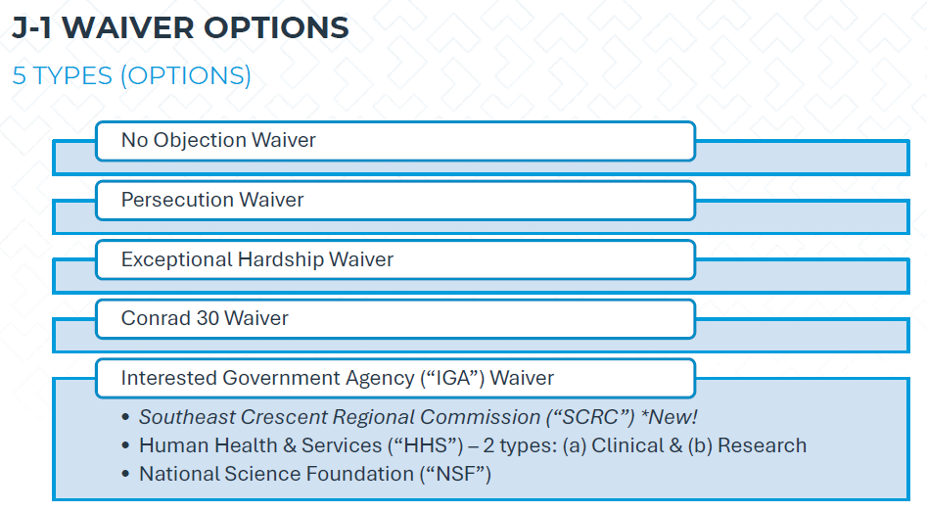
What is Section 212(e), and why is it such a big deal?
- not available for J1 clinical
- base on race, religion or political opinion
- on spouse or child
- employment in professional shortage area
Notes:
Acceptance under oath. VA could qualify as IGA, “extreme hardship”, Conrad = prioritization for primary care (30 cases per year/state)

Slide 8
Change of Status Applications
What transitions to what?
J1 Clinical
O1
H1B
E-3
PERM
Requires waiver or fulfillment of 212 (e)
J1 Clinical
J1 Research
F1/OPT
H1B
J1 Clinical
OR

Slide 9
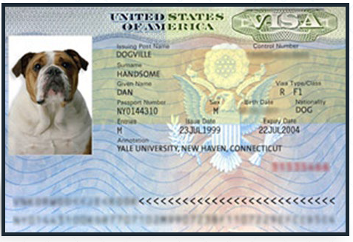

International Travel
In order to enter the US in a work visa status (like H-1B), the foreign national must present a valid, unexpired visa stamp for that classification (such as H-1B) (Canadian exemption)
In order to obtain the visa stamp, foreign nationals must complete an online application form (DS-160), make an appointment at their local Embassy/Consulate and present their original I-797 approval notice and a copy of the application package filed with USCIS
FN may need a letter from BIDMC supporting the need for an emergency visa appointment.

Slide 10
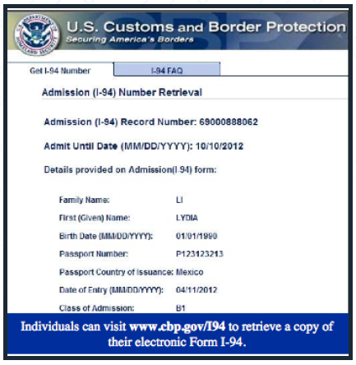
International Travel
After each international re-entry, the employee must print out their new I-94 (www.cbp.gov/i94)
MUST CHECK I-94 AFTER EACH TRAVEL TO MAKE SURE VISA CLASSIFICATION AND ADMIT UNTIL DATE ARE CORRECT
Whatever the I-94 says, prevails; if the I-94 has an earlier expiration, then that is the date we must be governed by
▪If there is a mistake on the I-94, seek guidance
FN may need a letter from BIDMC supporting the need for an emergency visa appointment.

Slide 11
International Travel
Increased consular processing delays have become more common, often due to enhanced vetting.
Most Consulates permit you to request an “emergency” appointment but there is a vast difference in adjudication of these.
Some individuals at US Embassy/Consulates are subjected to “Administrative Processing” this status is unpredictable (could be a few days or up to 6 months or MORE) and especially common for F and J individuals. (Most prevalent in India, China and Middle East and for individuals who are conducting research)
  Typically Administrative Processing cannot be expedited. Must wait for the process to run its course.
  Trainees should ALWAYS notify you when traveling.
        J1s, check Intealth advisories
        H1Bs notify Fragomen contacts
        Trainees may need a letter from BIDMC supporting the need for an emergency visa appointment

Slide 12
Documents to carry when traveling
Before travel, trainees should schedule a visa stamping appointment and have the following documents:
A valid passport
Original H-1B approval notice (Form I-797) or current DS-2019 (J1s)
A copy of H-1B petition filing
A recent employment verification letter from BIDMC confirming position, salary, and continued employment
Recent pay statements (we generally recommend bringing your last three pay stubs)
Any other documents requested by the U.S. Embassy or Consulate where applying for visa
Reviewing the U.S. Embassy or Consulate's website to understand the current visa appointment availability and application requirements before making travel plans is strongly advised.
Visa processing times can vary, and administrative processing may occur in some cases.
H1Bs: upon return, send Fragomen a copy of I-94 and visa stamp in order to update records.
What if trainee travels against advisement?
Notes:
J1s ONLY need DS-2019 & passport

Slide 13
How to Initiate Visa Processing
J1 Sponsorships
Processed through InTealth/ECFMG
H1B Sponsorships
Processed through Fragomen BILH Immigration Legal Counsel
GME Contact = Deborah Parnther
GME Contact = Laurie Dubois
Process begins Oct/Nov
Renewals Due by Dec 1st
Process begins in Dec via online submission form
Link below and posted on PC internal resources page: H1B Visa Intake Questionnaire
Notes:
Why two separate processes?

Slide 14
How to Initiate Visa Processing
J1 Required Info (PC)
J1 Offer Letters (new AY salaries, stipends and PGY levels)
H1B Required Info (PC)
Confirmation of Step III results
I-644 Form (if prior J1; confirmation of good standing)
Statement of Need Letter (new/hires and BIDMC program transfers)
Prior visa status (J1research, H1b, etc.) with expiration date
Sending country
Confirmed salary & PGY level
Program cost center information (for premium processing)
Program description (if not already on file or to reflect changes)
DS-2019 (if prior J1)
Additional documentation may be needed depending on case specifics
Confirmation of ALL work sites
All visa intakes DUE 2-weeks post-match
Notes:
Why two separate processes?

Slide 15


Timeline for Processing
H1Bs cannot proceed until MA license has been approved and Step III results have been submitted.
Attorney file prep is typically 4-6 weeks from receipt of all information
Labor and Conditions Applications (LCAs) require 10 business days + for processing.
Notes:
J1s = 1 month minimum (once all documents received) – discuss importance of LCAs!

Slide 16
Premium Processing (H1B cases)
Premium Processing (applies to H1Bs): USCIS will expedite review of an H-1B petition upon payment of a “Premium Processing” fee of $2,805. Premium Processing is initiated by standard course in alignment with the initial petition filing (new hires).
BIDMC H1B Renewals/Extensions generally do not require premium processing for employment purposes. The employee has up to 240 days of continued employment authorization pending the approval of the H-1B petition.
It may still be necessary to initiate Premium Processing if the petition has not been approved before the 240 day mark in order for the employee to maintain continued employment authorization.
Trainees cannot travel outside of the country while an extension petition is pending.
Notes:
Departments are expected to cover premium processing fees for extension filings if an emergency need arises (ex: care for a sick family member.
If the candidate needs expedited adjudication of the H-1B for personal reasons for his/her benefit, then the individual has the option to pay the premium processing fee directly.

Slide 17
What is an Request for Evidence (RFE)?
Examples of RFEs:
  Original/authenticity of a signature in question
  Maintenance of status, requires paystubs to show continued work while petition was pending
  Physician licensure validity period in question
Can create significant (weeks to months) delays.
Notes:
Once RFE response is received premium processing resets & resumes.

Slide 18
Recent Changes – Duration of Status
Elimination of “Duration of Status” (impacts J1 & F1 visas) – effective 9-15.26
Fixed admission periods will be based on the length of the training program (or four years), whichever is shorter.
Physicians in training programs longer than four years may eventually need an Extension of Stay (EOS) filing with U.S. Citizenship and Immigration Services (USCIS) or a new admission period through international travel and reentry.
Physicians with international travel scheduled during the 60-day transition period ending September 15, 2026, should coordinate with their Intealth Regional Advisor as travel may change how status is recorded.
*Intealth issuing new DS-2019s by the end of Aug.
*Notify Intealth no later than Sept 11 if a date correction is needed: dateconfirmation@intealth.org
*J1 physician webinar being offered on Sept. 3

Slide 19
Recent Changes – Proclamation 100K fee (H1Bs)
100K fee applicable to NEW H1B case initiations for individuals located outside the US went into effect as of 9.21.25.
ALERT: On June 8, 2026, the U.S. District Court for the District of Massachusetts issued an order that vacated agency guidance implementing the $100,000 payment requirement for certain H-1B petitions. See State of California v. Mullin, 1:25-cv-13829 (D. Mass.). DHS strongly disagrees with the court’s order and filed a motion to stay pending appeal with the United States Court of Appeals for the First Circuit (First Circuit). The District Court order was administratively stayed while the government pursued its motion to stay pending appeal with the First Circuit. On July 24, 2026, the First Circuit denied the government’s motion. DHS strongly disagrees with the First Circuit’s order denying the stay request but will comply with the court’s order while DHS considers next steps. If this order is later lifted, DHS still plans to collect the payment.

Slide 20

Country Specific H-1B Adjudication Pause
In December of 2025, 39-country specific adjudication pause went into effect.
As of June 5, 2026, the pause was lifted.
BIDMC impacts included current trainee awaiting OPT transition to H1B and new interns awaiting OPT approvals. Significant delays were experienced.

Slide 21

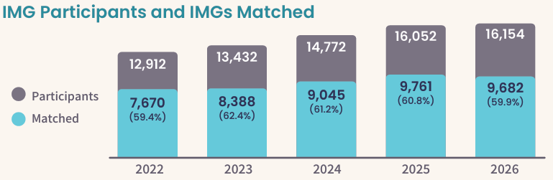
2026 Main Residency Match Data
Intealth.org
Notes:
9% of BIDMC main match in 2026 (8% in 2025; 11% in 2024)

Slide 22

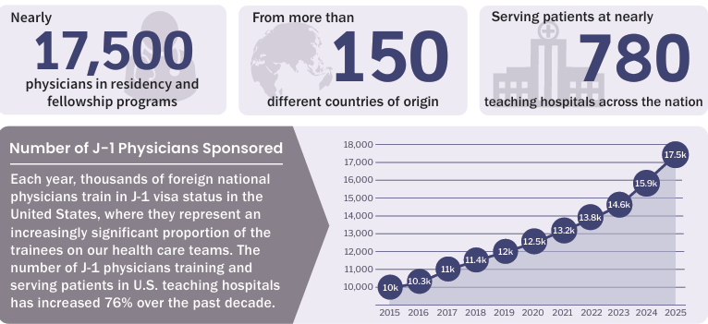

Slide 23
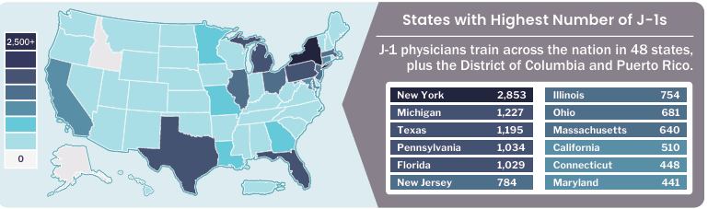

Slide 24
Future Considerations
National trends across GME
Changing policies
        J1/F1 Duration of Status
        Presidential Proclamations – 100K fee?
        Country specific adjudication pauses
        DACA uncertainty
        Pending lawsuits
        Future fee increases?
Embassy Appointment delays
Notes:
Form I94 “authorized period of stay”

Slide 25
What do we tell applicants?
At this time BIDMC sponsors both H1Bs (if already in the US in valid H1B status) and J1 visas.
The following statement can be shared with applicants:
“Given the ongoing uncertainty and rapidly changing environment related to visa sponsorships, we are unable to make any promises or guarantees about the organization’s ability to sponsor H-1B petitions for candidates. We remain committed to considering appropriate visa sponsorship options and are continually monitoring the updated guidance and information regarding visa sponsorship options.”

